Slide 1
Blending Tech with
the Human Touch
for WINNING
Travel Management
PURCO SA
1 NOVEMBER 2019

Slide 2
Who is ASATA?
Established in 1956
Is a representative forum that promotes professional service in the travel industry for both members and our clients
Represents over 90% of the travel industry in terms of market share
ASATA’s membership is voluntary and includes South African retail travel agents, travel management companies, wholesalers and suppliers of travel-related products and services
www.asata.co.za

Slide 3
Look for the ASATA Stamp of Credibility
Dealing with a Market Leader
Ethical Conduct
Trustworthy Behaviour
Professional Service
TRAVEL WITH PEACE OF MIND
www.asata.co.za

Slide 4
“Technology needs to be simple and implemented only when it enhances your business and enables business productivity.”

Slide 5
What is ‘Blended Tech’?
When the right technology blends seamlessly with human expertise so you eliminate human error and reduce abuse of your travel programme while allowing the human element to focus on more strategic travel management.

Slide 6
The benefits of Blended Tech
Greater efficiencies: For staff and buyers
Reduced cost of travel
Productivity gains
Generate insights for strategic travel management
Better planning and budgeting
Help bridge the generational divide
Travel Buyer

Slide 7
The benefits of Blended Tech
Easy-to-use online booking tools
Choice of booking options
Freedom within framework
Productivity gains
Greater efficiencies: For travellers
A sympathetic ear when travel goes awry
The ability to make an exception when necessary
Travellers

Slide 8
Human-first Approach
A successful blended technology strategy always needs to start with the company’s business, employees, culture and size.

Slide 9
Generational Divide
A successful blended technology strategy takes into account the nuances of different business travel requirements across generations, providing the latest technology and highly experienced travel experts.

Slide 10
We asked Business Travellers…
When they would use an Online Booking Tool vs a Travel Management Company…

Slide 11
Online Booking Tool
Look for flights, accommodation or car rental
Book flights, accommodation or car rental
Booking ancillary products
Check-In

Slide 12
Travel Management Company
Changing a flight
Sourcing advice or recommendations
Look for advice when something goes wrong

Slide 13
TMC beats OBT
Complex Itineraries
They saved me time
Personalised service
Knowledge of products and destinations
Convenience and hassle free
Knowing when to make an exception
Navigating generational divide

Slide 14
TMC beats OBT
A human consultant can help companies understand how staff travel, inform the company strategically how they can manage their travel better, and help them make appropriate changes to achieve a greater return on their corporate travel investment.

Slide 15
21st Century
Travel Agent Study
When something goes wrong, we look to a TA to make recommendations and change travel plans.
We will both look and book via an OBT and our TMC.
We check-in via OBT or through mobile. We don’t need a TA to do this for us.
Mobile technology, digital payment systems and internal communications are the most important services for me.
Ancillary and concierge services not that important

Slide 16
What specialist information are travel agents expected to have over technology?
Knowledge about hotels and airlines
General destination information
Safety and travel alerts
Ancillary information, e.g. best airport lounges

Slide 17
Which of the following technological functions and services are important to you in your business travel?
Mobile Technology
Digital Payments
Internal Company Communications

Slide 18
Travel Agents
are the safety net…

Slide 19
“We all want to talk to a 'live person' when we are dealing with a crisis and when we need to be the exception to the rule.”

Slide 20
“Progressive travel managers can bring travel friction issue forward, backed by data. Travel managers should ask their HR colleagues just how hard, and expensive it is, to replace a road warrior. They should also ask what is the road warrior attrition rate, and if this rate is high, average or low.”
~ Scott Gillespie

Slide 21
AI and bots will not replace human interaction but will undoubtedly help service providers to deliver a better and more personalised customer experience.

Slide 22
Most business travellers rate delivery of a personalised experience as …
very important or important.

Slide 23
TMCs enhance your business by…
Offering more personalised service
Putting together complex itineraries
Being more knowledgeable about destinations and product
Being a safety net in case something goes wrong
Offering strategic insights to help maximise the ROI of business travel
Helping to reduce traveller friction

Slide 24
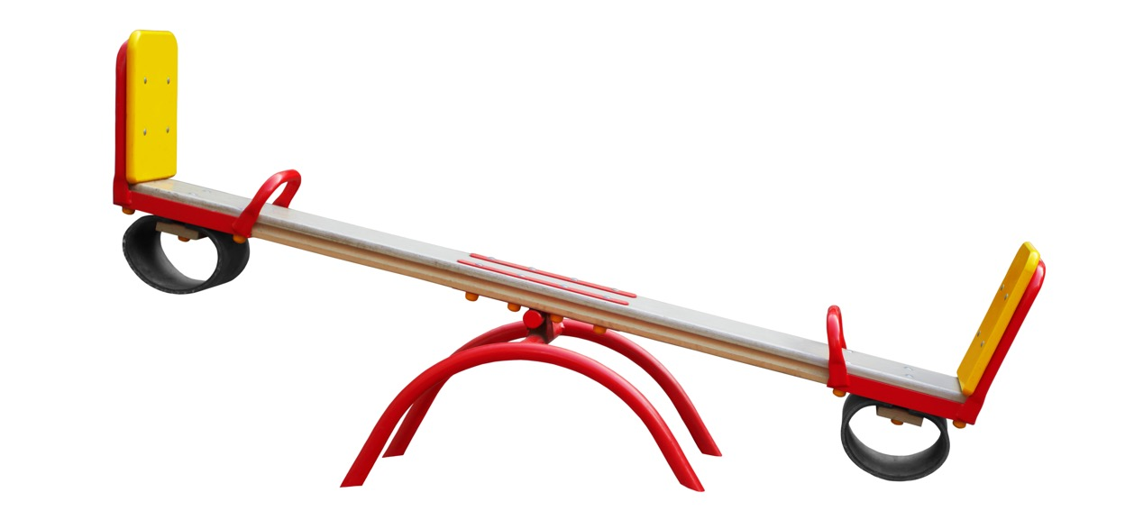
Companies need to learn how to balance the use of technology with the expertise of a human…

Slide 25
Questions?

